Slide 1

International Business
P T Manivannan
0221MBA002
International Expansion

Slide 2
Overview
1. Caterpillar Inc. is an American corporation that designs, manufactures and sells heavy machinery and engines for a variety of industries, including construction, mining, oil and gas, and manufacturing.
2. It is the world’s largest maker of construction and mining equipment, as well as a leading manufacturer of diesel and natural gas engines.
4. The company is composed of several businesses that specialize in diverse areas such as construction, engine, infrastructure and building systems.
5. Caterpillar Inc. has achieved numerous distinctions throughout the years, such as being listed as one of Fortune’s ‘World's Most Admired Companies’ in 2020.

Slide 3
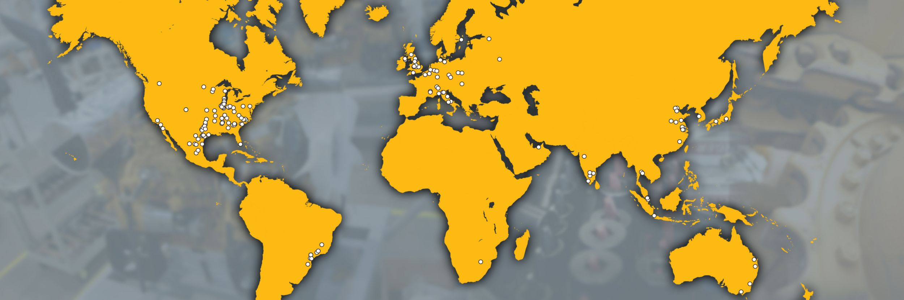
Global Locations
4
ASIA PACIFIC
Head Quarters:
USA
1
EAME
3
AMERICAS
2

Slide 4
Understanding the market

Slide 5
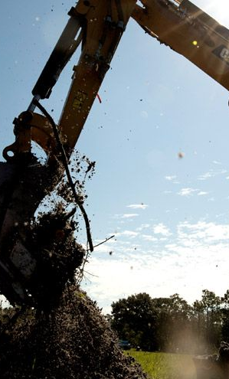

SWOT: CAT
Strengths:
- Strong brand recognition
- Global presence
- Diverse product portfolio
- Strong distribution network
- Innovation and technology
- Strong financial performance
Weaknesses:
- Dependence on the mining industry
- High operating costs
- Dependence on suppliers
- Environmental and regulatory challenges

Slide 6

SWOT : CAT
Opportunities:
- Growing demand for construction and infrastructure
- Technology advancements
- Expansion into emerging markets
- Electric and alternative energy solutions
Threats:
- Intense competition
- Economic downturns
- Natural disasters and political instability
- Fluctuating commodity prices

Slide 7
Pestle analysis
Political:
The US government's policies, regulations and taxes can impact Caterpillar's operations and revenue.
The UAE government's stable political environment and pro-business policies
Economic:
Trade policies and tariffs imposed by the US government and the Unstable economy of USA in recent past
The UAE has a strong construction and infrastructure sector
The country's declining oil prices

Slide 8
Pestle analysis
Social:
The aging workforce in the US can lead to a shortage of skilled labor
The UAE's growing population and urbanization have led to an increased demand
Technological factors:
Increase in automation and digitalization
The increasing use of electric and hybrid vehicles may impact the demand for diesel engine
The UAE is investing heavily in renewable energy
The country's focus on smart cities and infrastructure

Slide 9
Pestle analysis
Legal:
Legal Issue with USA due to Usage of CAT in Iraq Troops
Conflict with china
UAE doesn't have many rules except its Environmental Policy
Environmental:
CAA ( 2011)
Green Energy in both USA and UAE are growing
Emissions from Diesel Engines

Slide 10

Inception in USA and UAE
Caterpillar Inc. entered the US market by first establishing a corporate office in San Francisco in 1925.
The company opened its first manufacturing facility in Stockton, California in 1926
Caterpillar began producing and selling its first earthmoving equipment, the 2-Ton Tractor from 1927
Today, a large majority of Caterpillar's products are designed and manufactured in the US.

Slide 11
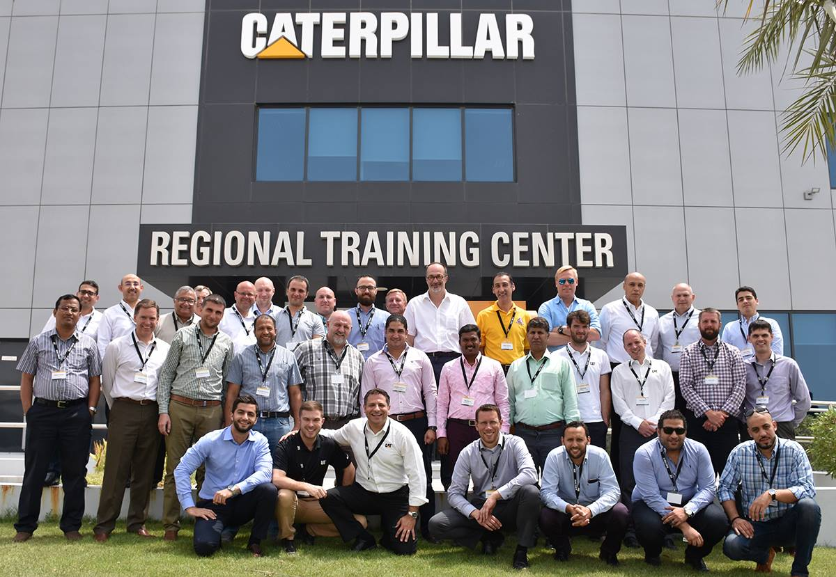
UAE:
In 2015 announced that it will build a Regional Training Center for the African and Middle East Region (AME) in Dubai
At an investment of more than $7 million, the approximately 1,700 m2 center will employ about 40 people, mostly high-level technical staff who will primarily be recruited from the region

Slide 12
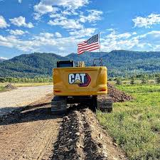
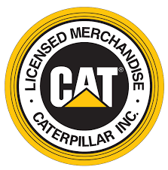
Strategies For USA
High tariffs and arrests: posed disruptions and cost to Caterpillar Inc, strategies such as finding loopholes and lobbying helped mitigate impact
Increased competition: faced lowered profitability, countered with providing quality products and services, investing in research and development
New regulations: adapted to changes through close collaboration with local governmental bodies, invested in training and education for employees
Strategic alliances: measures such as strict control and clear objectives helped manage risks associated with partnerships

Slide 13
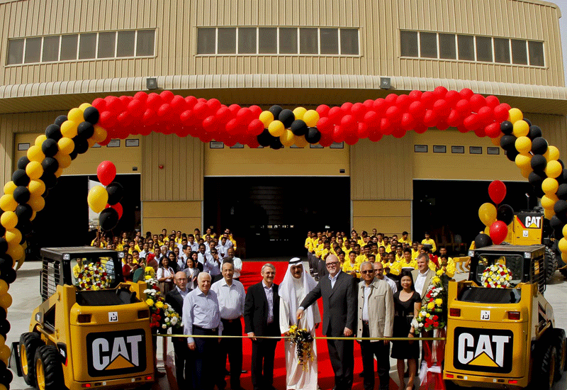
Strategies For UAE
1. Access to markets: need to compete with established domestic companies
2. Regulation: strict laws and regulations to comply with
3. Cost of doing business: high labor costs, taxes and expenses to manage
4. Local competition: high degree of competition from local companies, need to understand market and develop competitive advantages

Slide 14
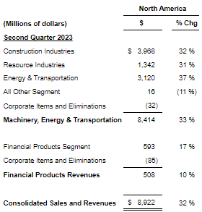
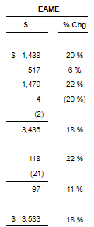
USA vs UAE
Revenue
- USA: $47.7 billion
- UAE: US$220 million
Profit Margin
- USA: 14.92%
- UAE: 8.19%

Slide 15
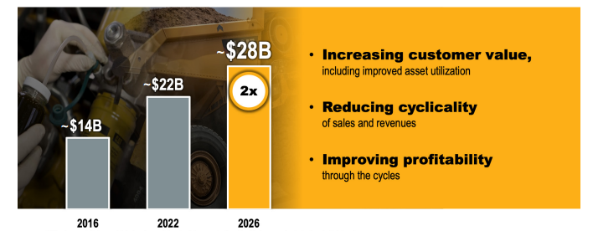
Conclusion
As of Now we can say that the FDI done by CAT in UAE is Successful
CAT has Also Done FDI in countries like China through M&A
GreenField Investment in Brazil, India, Russia, Mexico
Overall International Expansion of Caterpillar Incorporation Has been successful

Slide 16
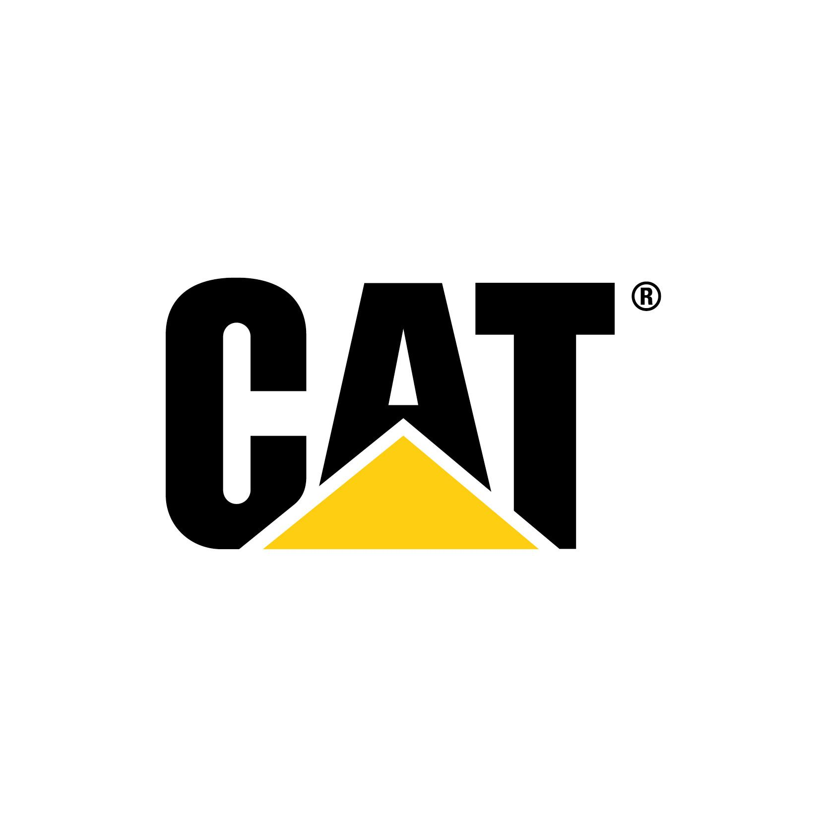
Thank you.

